Slide 1
Machine Learning: Algorithms and Applications
Linear Discriminants
Week 4

Slide 2
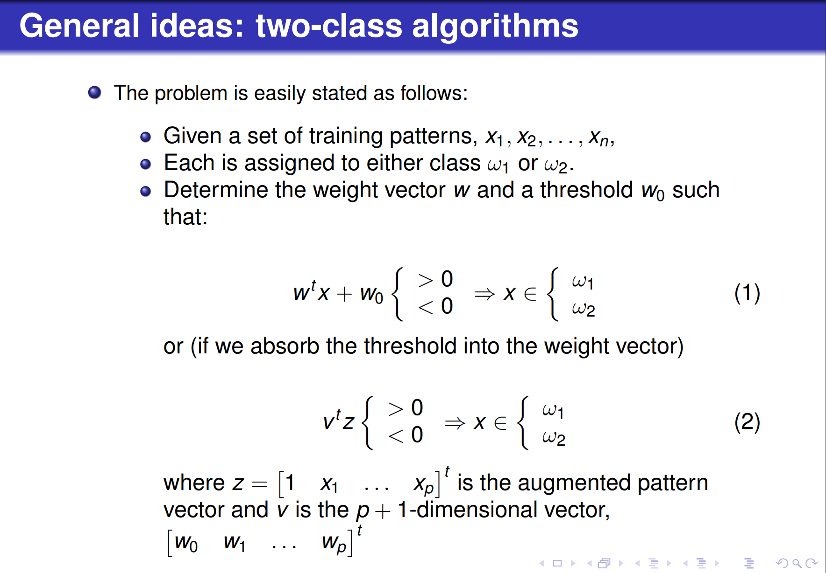

Slide 3
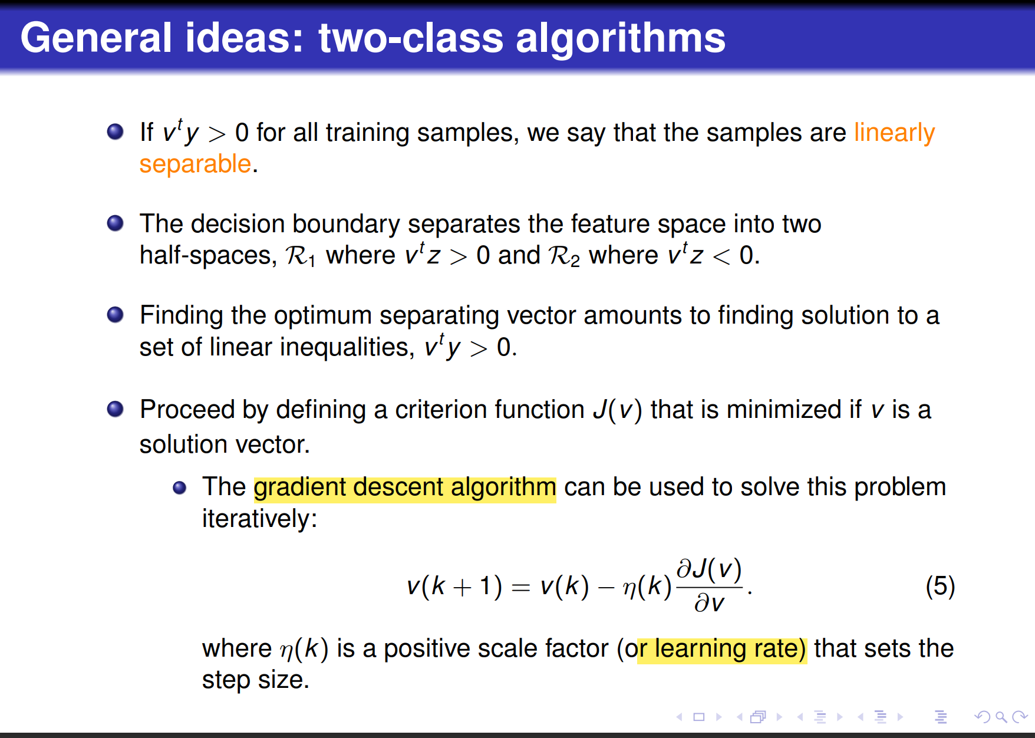

Slide 4
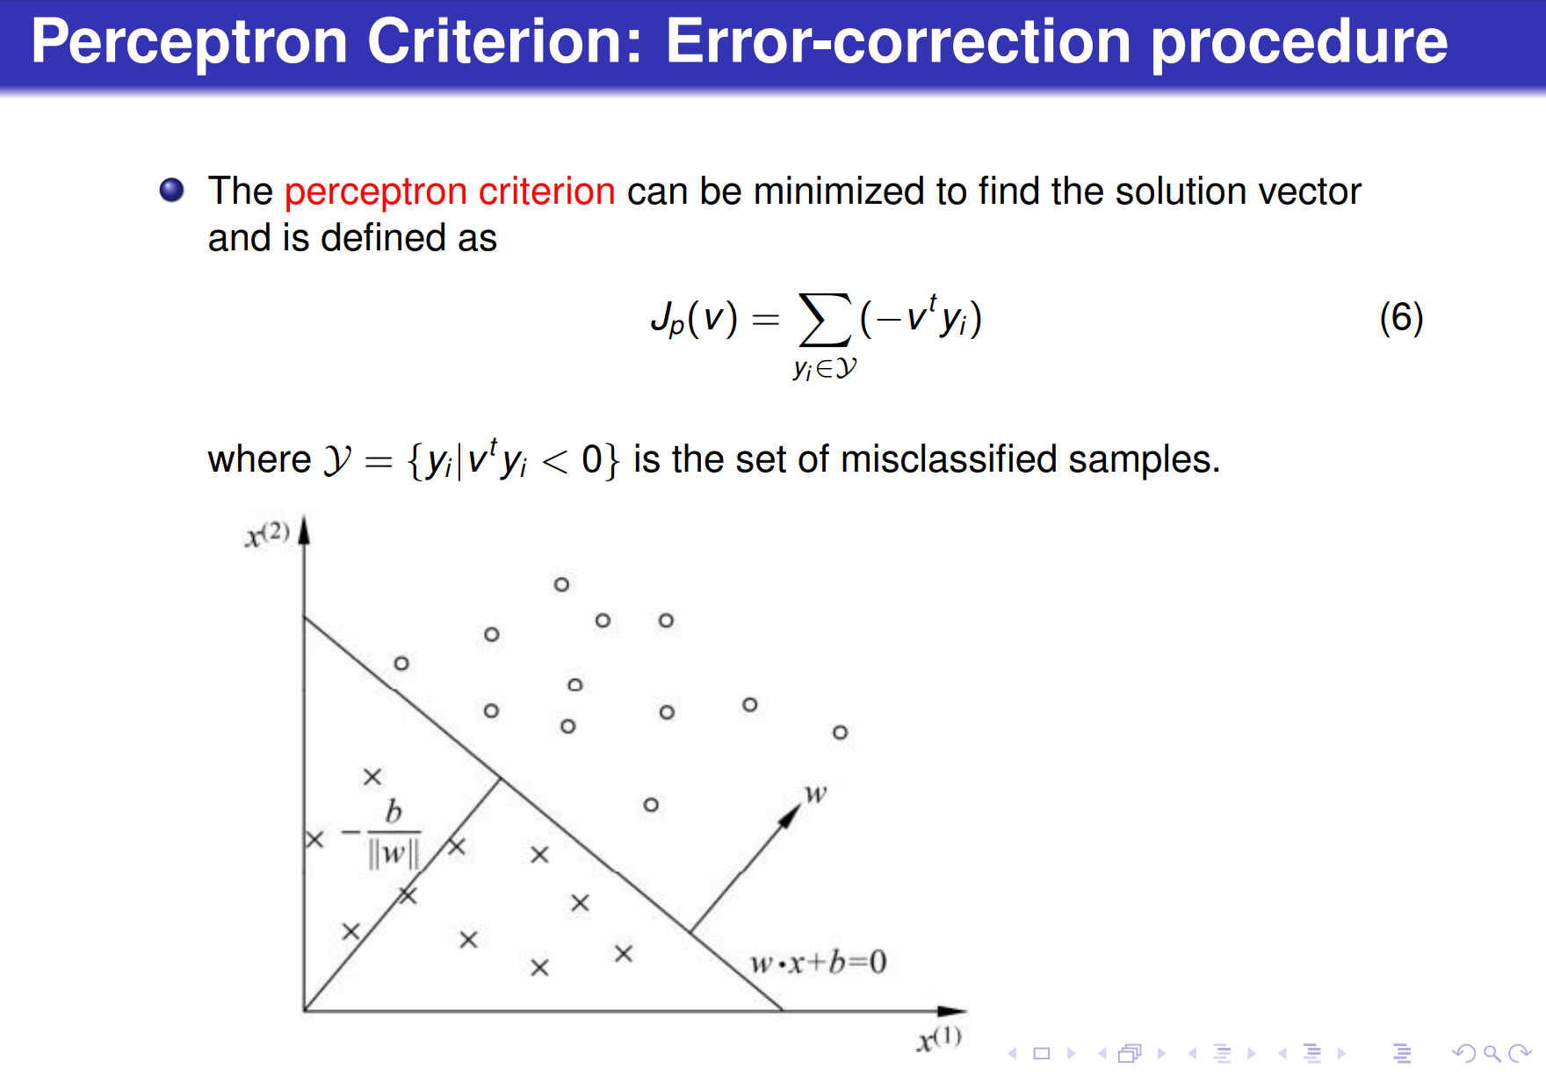

Slide 5
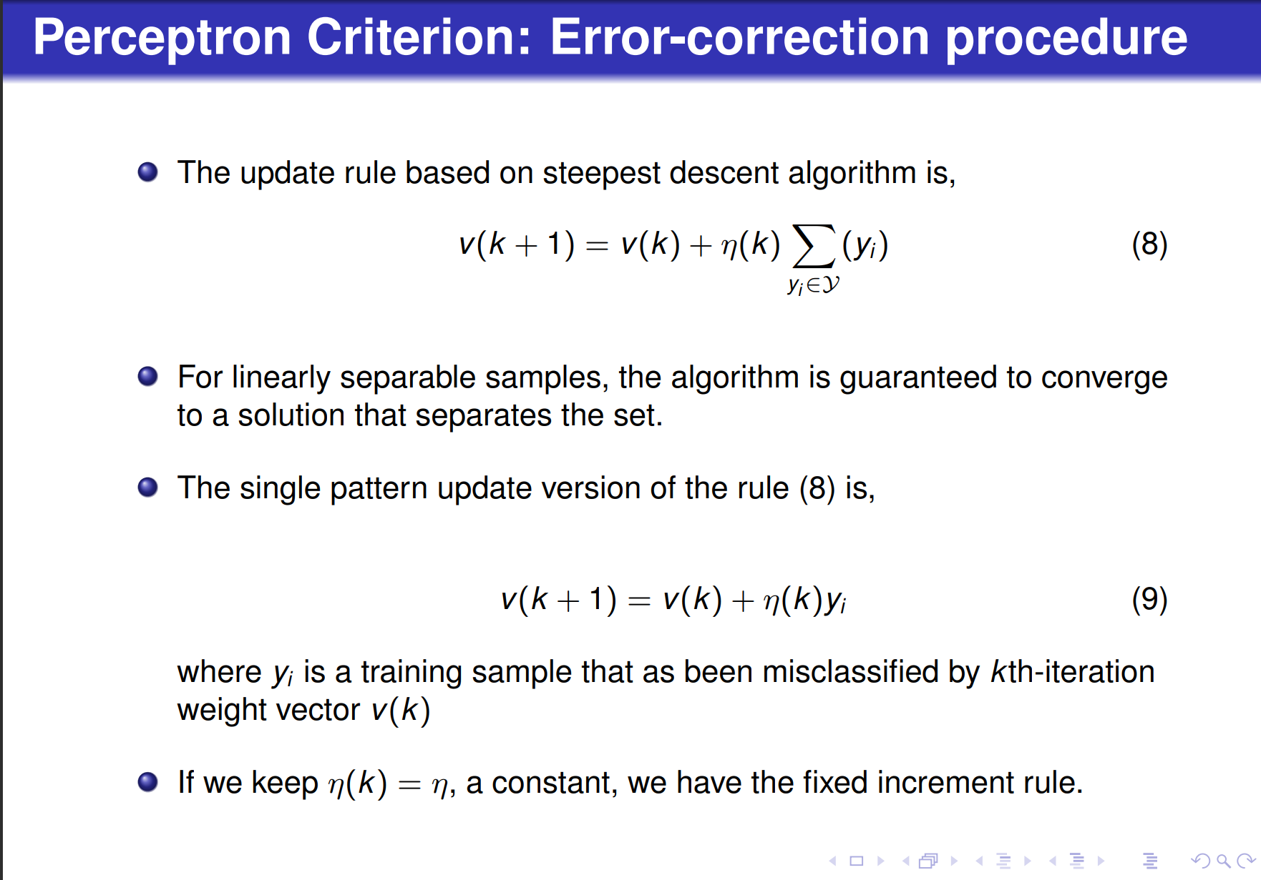

Slide 6
Perceptron
Implementation of Perceptron in Python.
Now, Implement the algorithm of Perceptron in Python.
Check documents and datasets in Moodle for reference.
Or visit links below for reference:
https://machinelearningmastery.com/perceptron-algorithm-for-classification-in-python/
https://machinelearningmastery.com/implement-perceptron-algorithm-scratch-python/

Slide 7
Perceptron
An example
From 《统计学习方法》李航 著

Slide 8
Perceptron
An example

Slide 9
Perceptron
Solution

Slide 10
Perceptron
Solution

Slide 11
Perceptron
Solution

Slide 12
Perceptron
Solution

Slide 13
Perceptron
Solution

